Slide 1


DEPARTMENT OF BIOINFORMATICS
ALAGAPPA UNIVERSITY
A CHEMINFORMATICS APPROACH FOR PROTAC-MEDIATED CLEARANCE OF PARKINSON’S DISEASE PROTEIN AGGREGATES
Under the Supervision of
Dr. R.M.VIDHYAVATHI
Assistant professor
Department of Bioinformatics
Alagappa University, Karaikudi
Sadana priti R
Reg. No. 2023502020
(MSc II - year)
Department of Bioinformatics
Alagappa University, Karaikudi

Slide 2
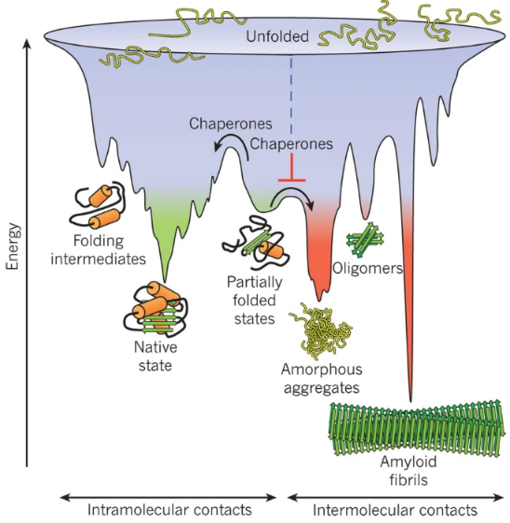
INTRODUCTION
Protein aggregation is the process where individual protein molecules stick together and form clumps or clusters.
This usually happens when proteins are misfolded or unstable, and it can make them insoluble and inactive.
The formation of these aggregates promotes loss of protein function, saturates the protein quality control machinery, and leads to aberrant interactions and the subsequent co-aggregation of other essential cellular proteins.

Slide 3
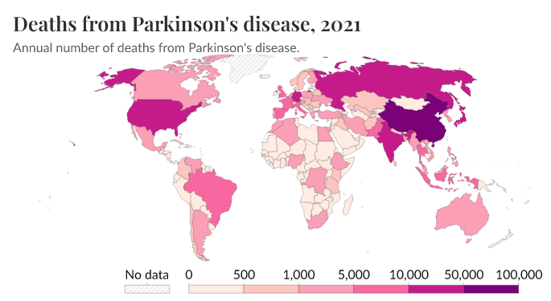
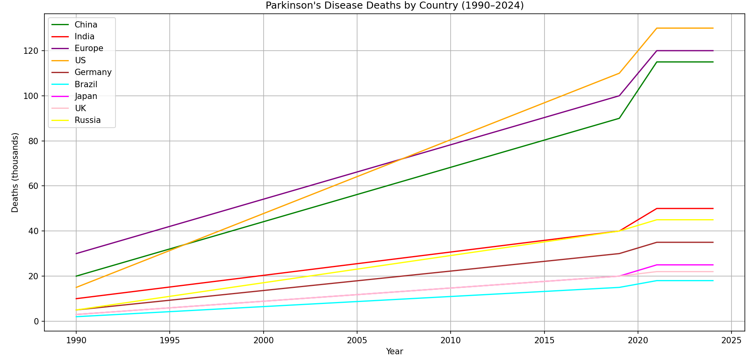
PARKINSON’S DIESEASE
PARKINSON’S DISEASE
Mutation in SNCA gene (A53T, A30P, E46K)
Misfolded α‑synuclein forms β-sheets and aggregates
Passed on as autosomal dominant trait
Function: Binds to phospholipids in neurons
Residues 61–95: hydrophobic segment with β‑sheet‑forming potential
Deficiency of dopamine

Slide 4
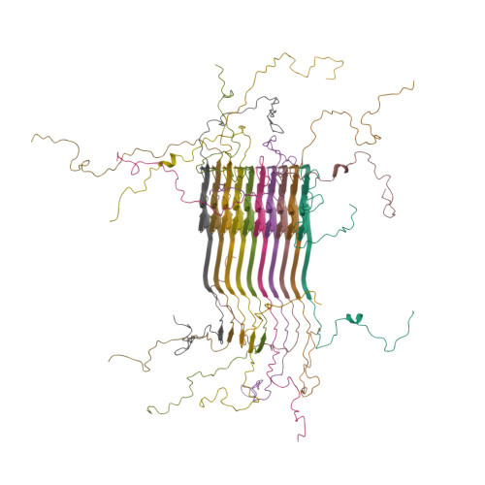
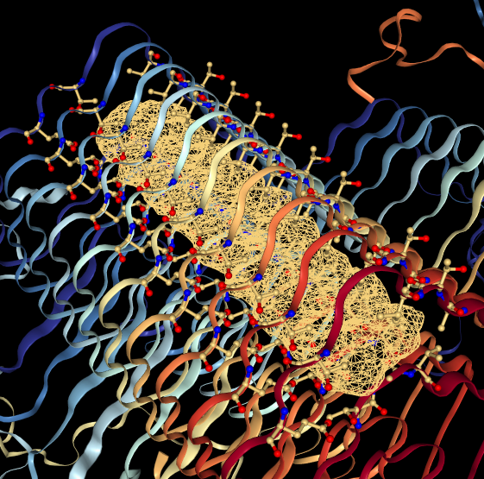
Structure of alpha-synuclein fibrils
ALA_53_A THR_54_A VAL_55_A THR_59_A GLU_61_A THR_72_A GLY_73_A VAL_74_A ALA_53_B THR_54_B VAL_55_B THR_59_B GLU_61_B THR_72_B GLY_73_B VAL_74_B ALA_53_C VAL_55_C THR_59_C GLU_61_C THR_72_C GLY_73_C VAL_74_C ALA_53_D THR_54_D VAL_55_D THR_59_D GLU_61_D | THR_72_D GLY_73_D VAL_74_D ALA_53_E THR_54_E VAL_55_E THR_59_E GLU_61_E THR_72_E GLY_73_E VAL_74_E ALA_53_F THR_54_F VAL_55_F THR_59_F GLU_61_F THR_72_F GLY_73_F VAL_74_F ALA_53_G THR_54_G VAL_55_G THR_59_G GLU_61_G THR_72_G GLY_73_G VAL_74_G | ALA_53_H THR_54_H VAL_55_H THR_59_H GLU_61_H THR_72_H GLY_73_H VAL_74_H ALA_53_I THR_54_I VAL_55_I THR_59_I GLU_61_I THR_72_I GLY_73_I VAL_74_I ALA_53_J VAL_55_J THR_59_J GLU_61_J THR_72_J GLY_73_J VAL_74_J
2N0A
Misfolded α-synuclein amyloid fibrils are the principal components of Lewy bodies and neurites, hallmarks of Parkinson's disease (PD).

Slide 5
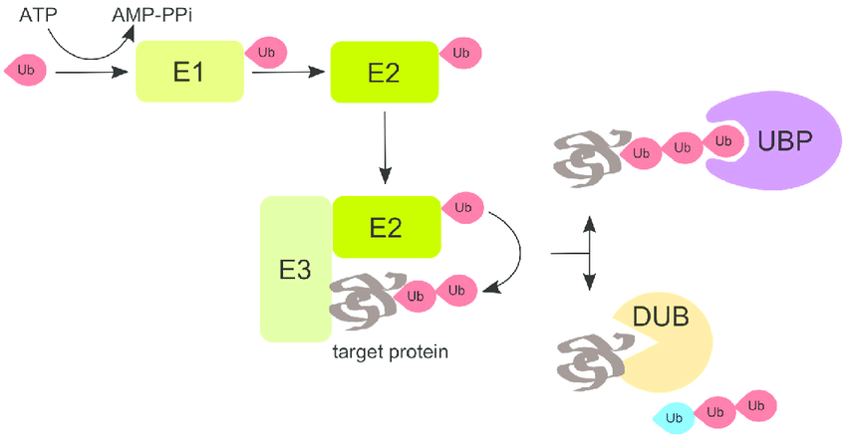
Ubiquitination
Ubiquitin-activating enzyme (E1)
E1 links to the C-terminal glycine of ubiquitin via a thioester bond
Ubiquitin-conjugating enzyme (E2)
Activated ubiquitin is transferred from E1 to the active site cysteine of E2
Ubiquitin ligase (E3)
E3 facilitates transfer of ubiquitin from E2 onto a lysine side chain of the target protein

Slide 6
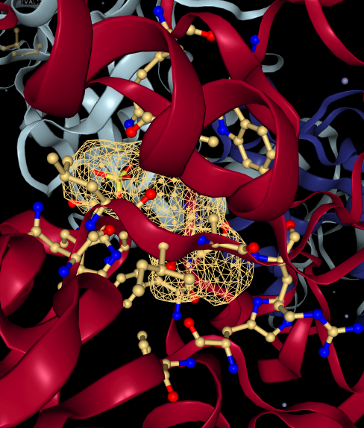
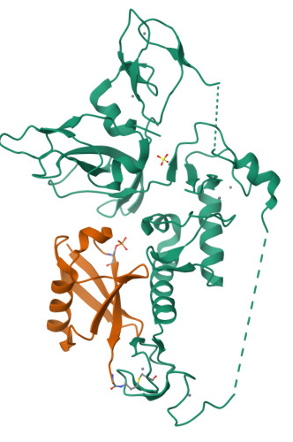
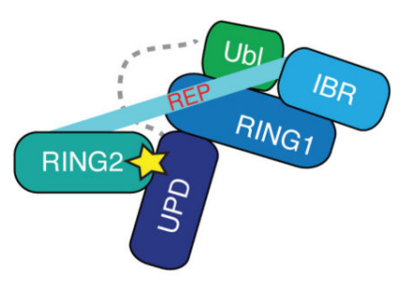
Structure of Pediculus humanus Parkin bound to phospho-ubiquitin
HIS_146_A PHE_147_A GLN_182_A SER_183_A TRP_184_A ASN_229_A LEU_230_A ILE_231_A LYS_232_A ARG_233_A VAL_252_A SER_254_A ARG_258_A TRP_400_A GLY_427_A PHE_460_A GLY_461_A
5CAW
E3 ubiquitin ligase parkin in complex with Ser65-phosphorylated ubiquitin.
The model comprises the RBR-type parkin core—including a Ubl domain, RING0, RING1, IBR, and RING2 zinc-finger domains—bound to phospho-ubiquitin.

Slide 7
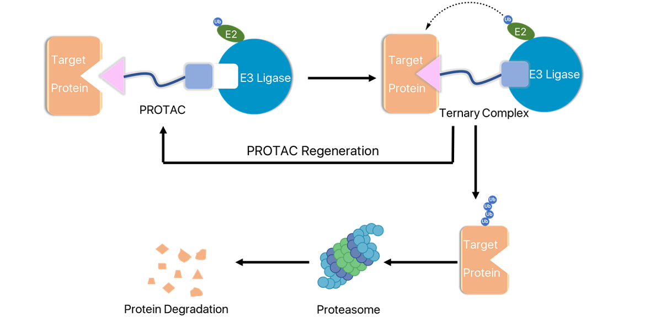
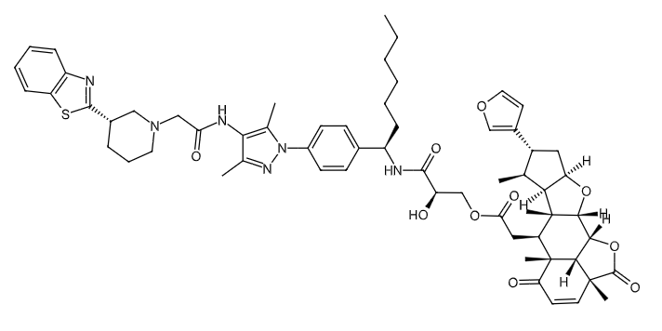
PROTACs
Proteolysis-Targeting Chimeras, are a class of molecules designed to selectively degrade specific proteins within a cell by hijacking the cell's natural protein degradation machinery, the ubiquitin-proteasome system (UPS).

Slide 8
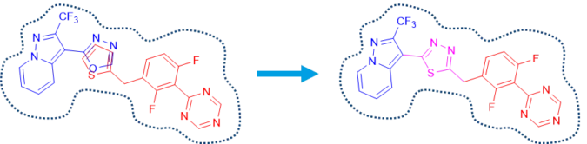
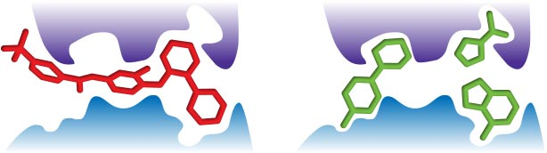
Fragment-based drug discovery (FBDD)
It is a powerful method to develop potent small-molecule compounds starting from fragments binding weakly to targets.

Slide 9
AIM
To develop and computationally validate novel PROTAC molecules that selectively target and promote the degradation of α-synuclein aggregates implicated in Parkinson’s disease.
Objective
Analyze the molecular mechanisms and pathways involved in protein aggregation diseases, with emphasis on Parkinson’s disease.
Identify key protein targets involved in the aggregation process, such as α-synuclein, and select Parkin E3 ligase as a degradation mediator based on its role in the ubiquitin–proteasome pathway and literature-supported relevance.
Retrieve and filter bioactive compounds and fragments from the Enamine database using Lipinski’s Rule of Five and Rule of Three.
Obtain validated binders and linker scaffolds from PROTAC-DB for constructing functional PROTAC molecules.
Perform virtual screening and docking studies to model interactions between PROTACs, the protein of interest (α-synuclein), and the E3 ligase complex (Parkin).
Compare the efficiency of PROTACs designed with conventional warheads versus those built using fragment-based strategies.
Density Functional Theory (DFT) calculations

Slide 10
Protein Selection based on reference literature and retrieve from Protein Data Bank(PDB)
Retrieve Libraries
Enamine Bioactive Libraries
Enamine Fragment Libraries
Compound–Fragment Matching using molecular fingerprints
Bioactive compounds filtered using Lipinski's Rule of 5.
Fragments filtered using Rule of 3.
PROTAC Component Retrieval
Known binders and linkers retrieved from the PROTAC-DB database
Active Site Prediction
CASTp Server
Virtual Screening
Binders docked with 5CAW protein, Bioactive compounds (warheads) docked with 2N0A protein using AutoDock Vina.
Protein–Protein Docking
Protein–protein complex formation simulated using HADDOCK.
PDBsum used to identify key residues
FBDD - Matched fragments used to synthesize a new warhead candidate via fragment growing & linking
PROTAC 1: Binder + Linker + Bioactive Compound PROTAC 2: Binder + Linker + FBDD-Generated Warhead
PROTAC Docking with Protein–Protein Complex
Density Functional Theory Calculation
involved in protein–protein interaction.
W
O
R
K
F
L
O
W

Slide 11
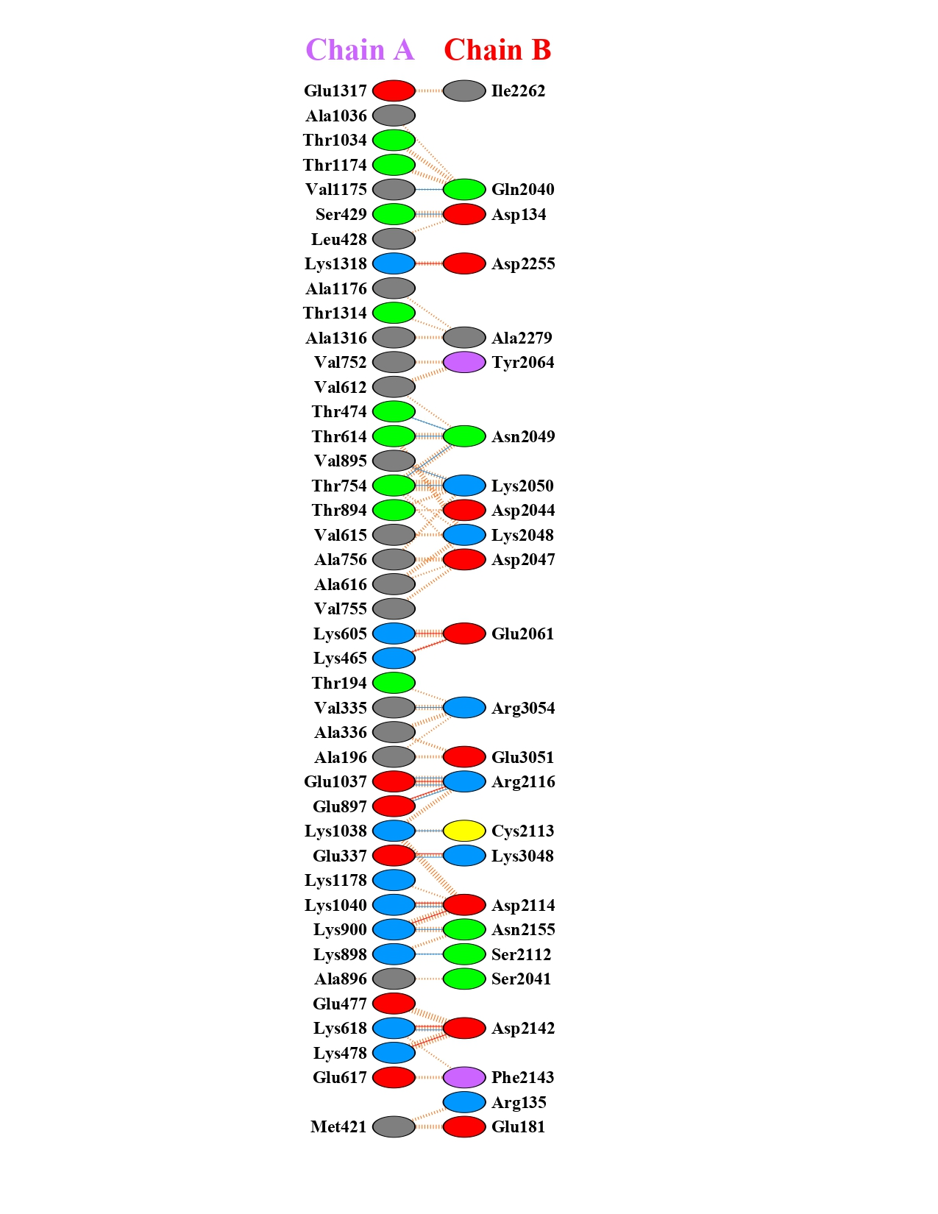
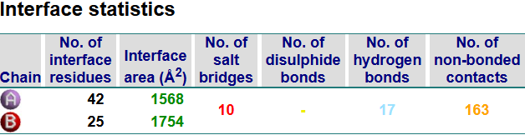
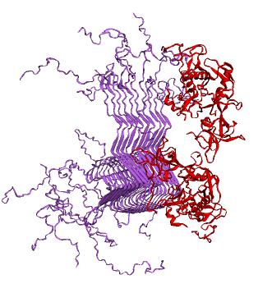
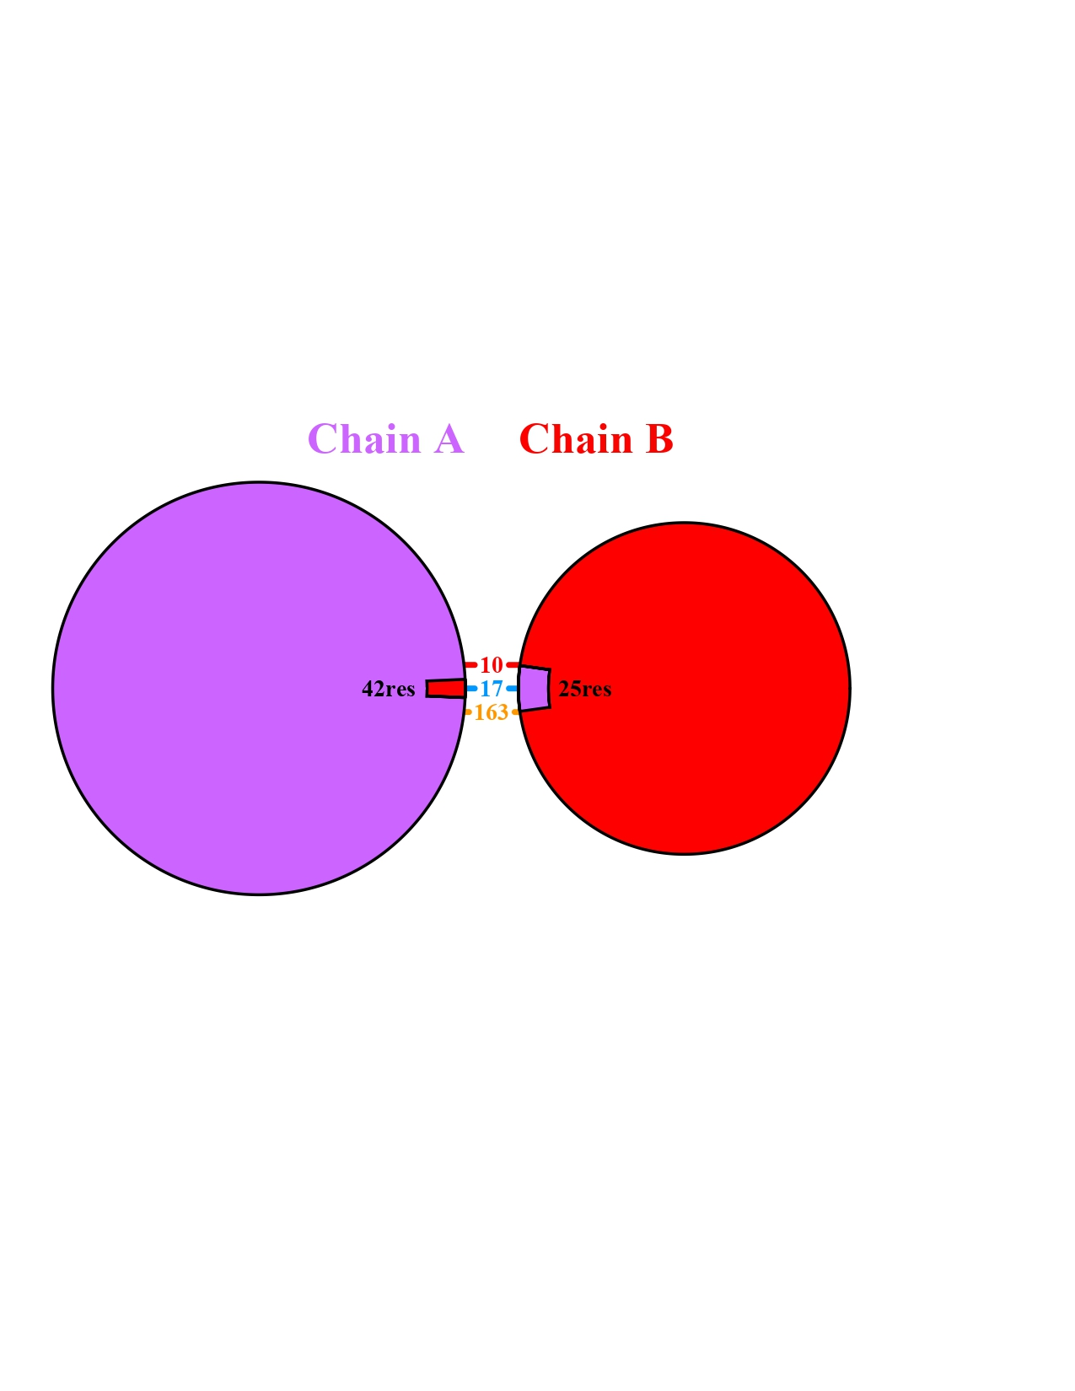
Protein – Protein Docking

Slide 12
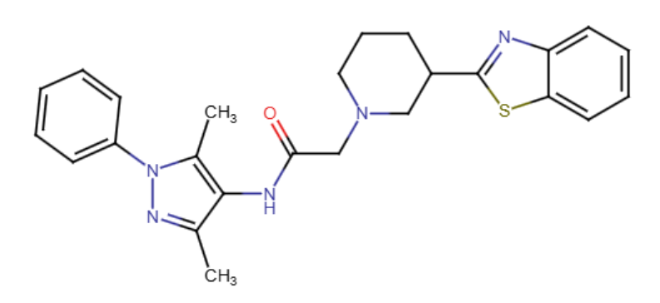
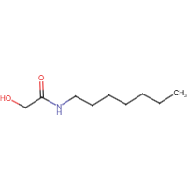
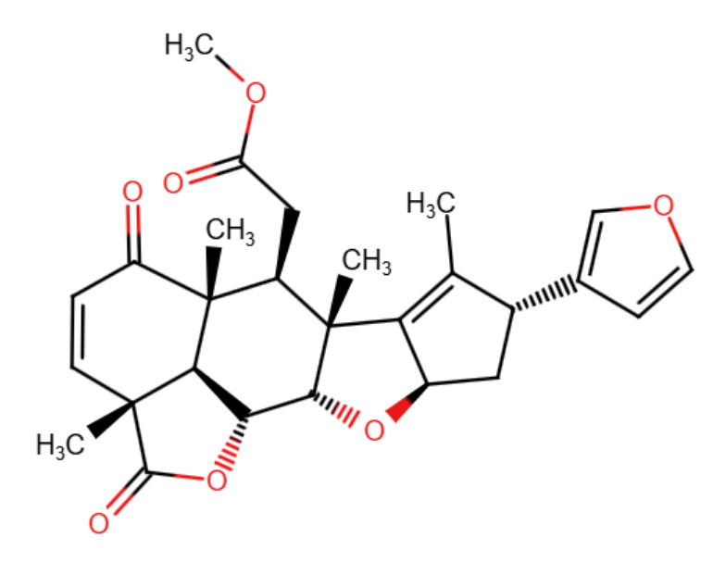
PROTAC components | NAME | SMILES | MOLECULAR WEIGHT | STRUCTURE
WARHEAD | 2-[3-(1,3-benzothiazol-2-yl)piperidin-1-yl]-N-(3,5-dimethyl-1-phenyl-1H-pyrazol-4-yl)acetamide (CID 16358423) | CC1=C(C(=NN1C2=CC=CC=C2)C)NC(=O)CN3CCCC(C3)C4=NC5=CC=CC=C5S4 | 445.6 g/mol
LINKER | N-heptyl-2-hydroxyacetamide (CID 135304905) | CCCCCCCNC(=O)CO | 173.25 g/mol
BINDER | NIMBOLID (CID 12313376) | CC1=C2[C@@H](C[C@H]1C3=COC=C3)O[C@H]4[C@@]2([C@@H]([C@@]5([C@H]6[C@H]4OC(=O)[C@@]6(C=CC5=O)C)C)CC(=O)OC)C | 466.5 g/mol

Slide 13
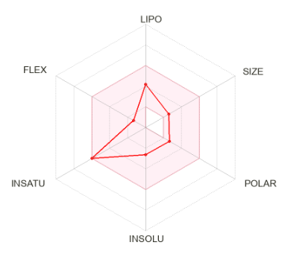
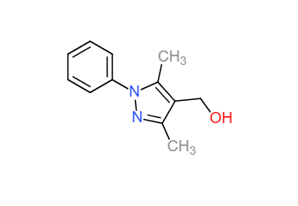
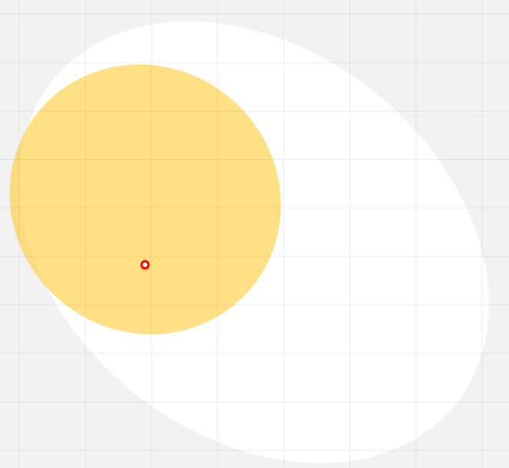
FRAGMENT BASED DRUG DESIGN
Compound–Fragment Matching
(2405 Fragments)
Lipinski's Rule of 3 (1676 Fragments)
Matched fragment with highest affinity compound
(3,5-dimethyl-1-phenylpyrazol-4-yl)methano
259 380 Fragments
IUPAC Name | (3,5-dimethyl-1-phenylpyrazol-4-yl)methanol
SMILES | CC1=C(C(=NN1C2=CC=CC=C2)C)CO
Pubchem ID | CID 2526674
LogP | 1.97
HBond_Donor | 2
HBond_Acceptor | 1
Molecular Weight | 202.25
Bioavailability Score | 0.55
Lipinski violations | 0
Best Matching | Z46486555
Matching Percentage | 31.81818182

Slide 14
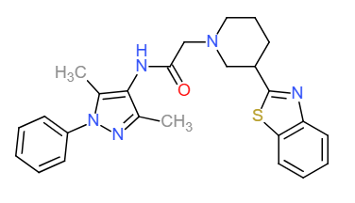
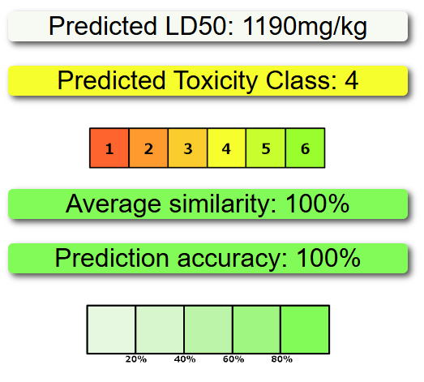
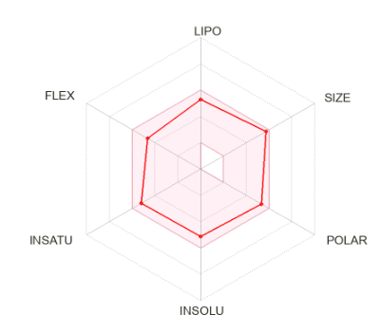
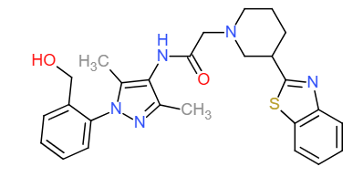
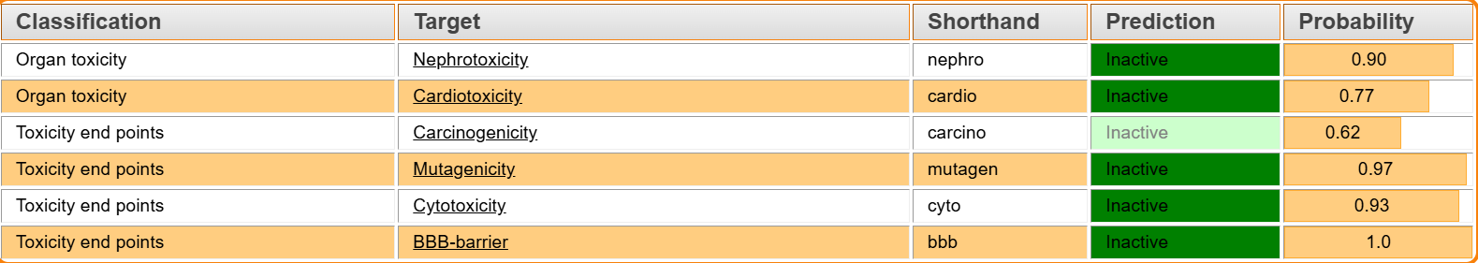
Fragment based drug design

Slide 15
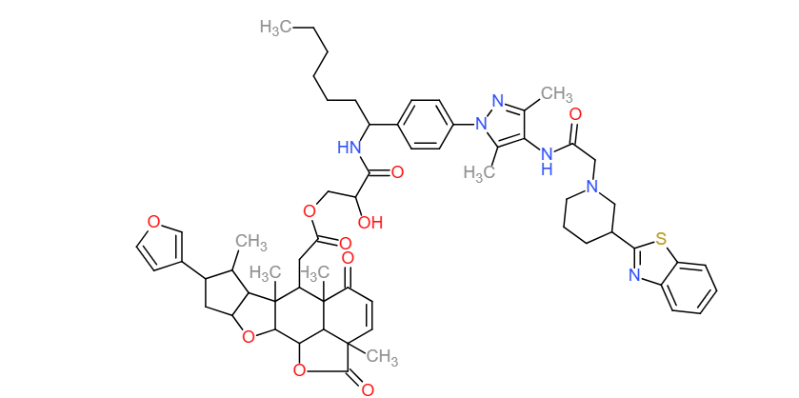
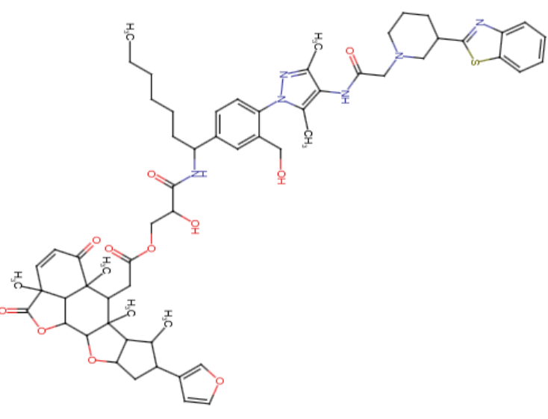
PROTAC JOINED USING RDKIT
PROTAC 1 : Binder + Linker +
Bioactive Compound
PROTAC 2 : Binder + Linker + FBDD-Generated Warhead

Slide 16
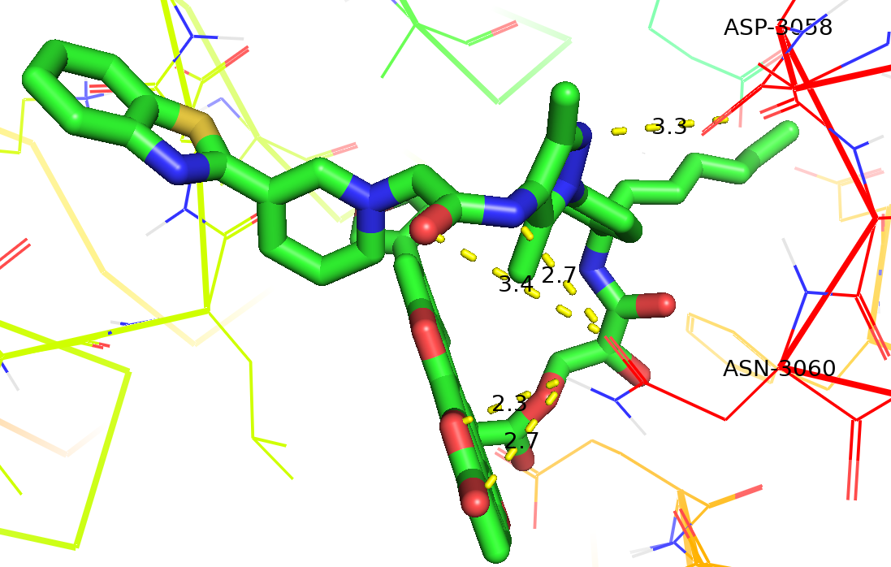
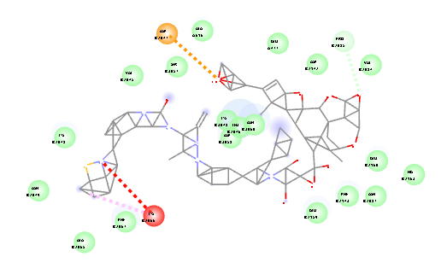
PROTAC 1
Binding affinity -13.39 kcal/mol
Hydrogen bond - His 2162, Arg 2165, Asn 2049, Lys 2050, Ile 2051, Phe 2067, Asn 3060
Salt bridges - His 2162, Arg 2165, Asp 3058

Slide 17
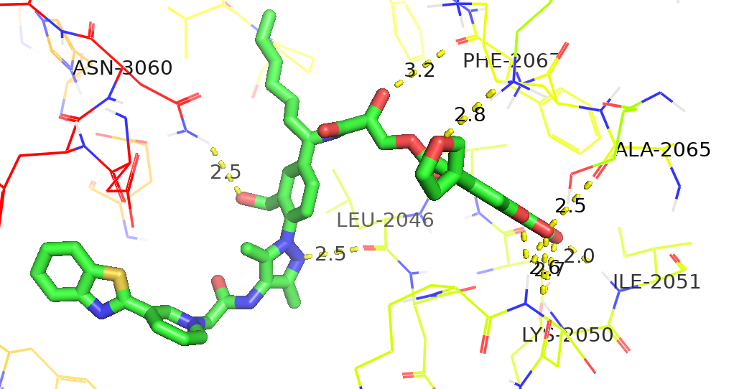
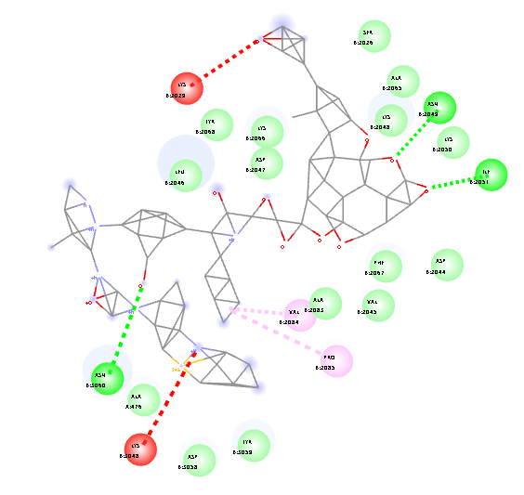
PROTAC 2
Binding Affinity -18.31 kcal/mol
Hydrogen bonds Glu 2160, His 2162, Arg 2165 and Asn 3060
Salt bridges His 2162 and Arg 2165
Hydrophobic contacts with Leu 2046, Lys 2050, Ile 2051, Ala 2065 and Phe 2067

Slide 18
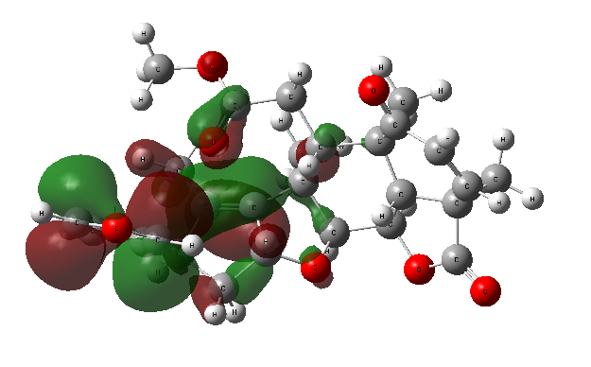
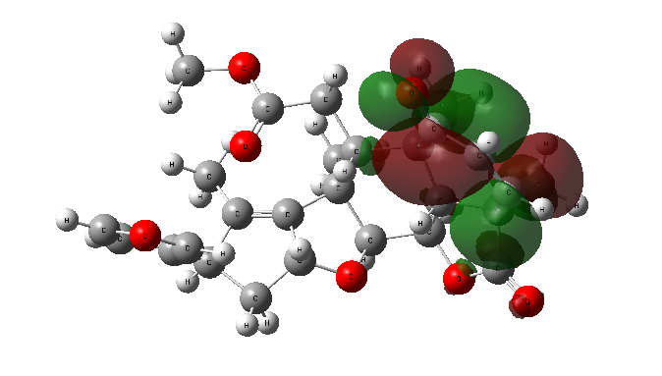
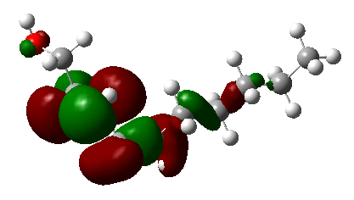
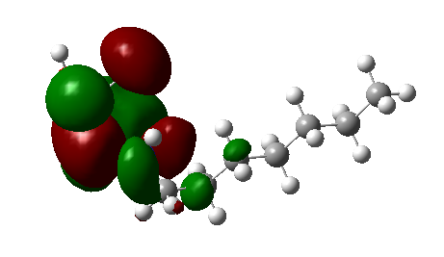
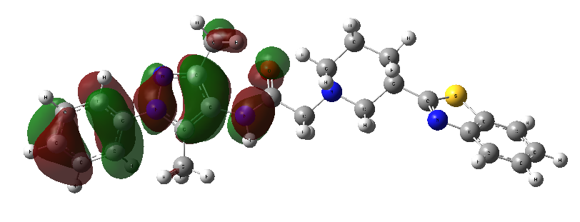
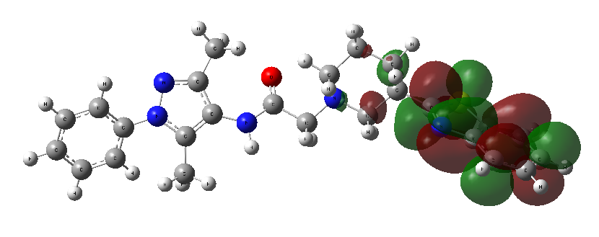
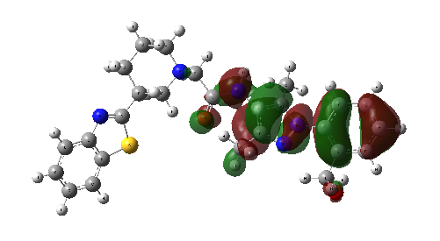
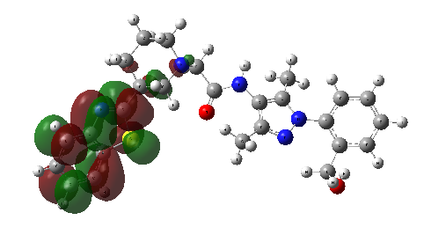
DENSITY FUNCTIONAL THEORY
HOMO-LUMO Structure of Binder (CID 12313376) HOMO-LUMO Structure of Linker (CID 135304905)
HOMO-LUMO Structure of Warhead (CID 16358423) HOMO-LUMO Structure of FBDD Generated Warhead
Fig: HOMO-LUMO Structure of FBDD Generated Warhead

Slide 19
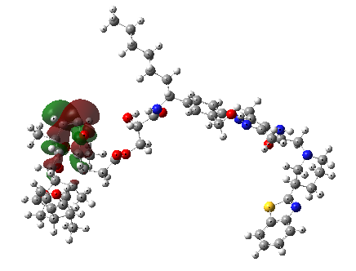
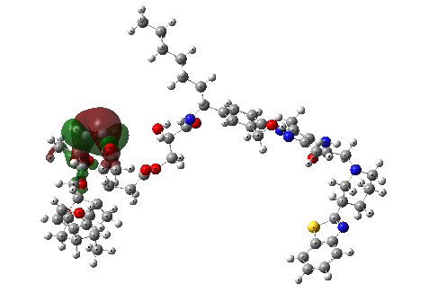
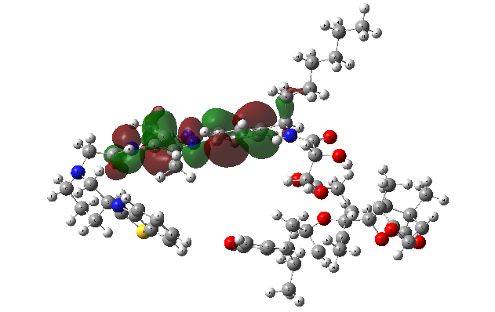
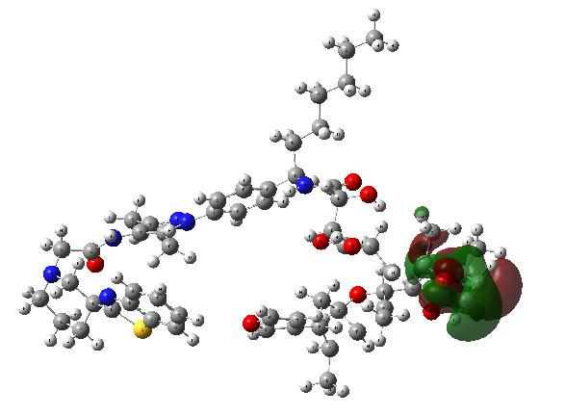
HOMO - LUMO Structure of
PROTAC 1
HOMO - LUMO Structure of PROTAC 2

Slide 20
Compounds | EHOMO (eV) | ELUMO (eV) | ΔEgap (–ve) | Dipole (D) | IP (eV) | EA (eV) | η (eV) | σ (eV⁻¹) | χ (eV) | ω (eV) | ΔN
BINDER | –8.323 | –2.241 | –6.082 | 4.2109 | 8.323 | 2.241 | 3.041 | 0.329 | 5.282 | 2.641 | 1.737
LINKER | –7.683 | –2.510 | –5.173 | 2.1456 | 7.683 | 2.510 | 2.587 | 0.387 | 5.096 | 2.547 | 1.968
WARHEAD | –7.892 | –2.138 | –5.754 | 3.7890 | 7.892 | 2.138 | 2.877 | 0.348 | 5.015 | 2.501 | 1.743
PROTAC 1 | –8.503 | –2.164 | –6.339 | 5.6789 | 8.503 | 2.164 | 3.170 | 0.315 | 5.334 | 2.677 | 1.681
FBDWARHEAD | –8.310 | –2.841 | –5.469 | 7.0176 | 8.310 | 2.841 | 2.735 | 0.366 | 5.576 | 5.682 | 2.039
PROTAC 2 | –8.131 | –2.289 | –5.842 | 4.3210 | 8.131 | 2.289 | 2.921 | 0.342 | 5.210 | 2.611 | 1.785

Slide 21
CONCLUSION
This work demonstrates a robust Cheminformatics approach for designing Proteolysis‑Targeting Chimeras (PROTACs) to selectively degrade α‑synuclein aggregates in Parkinson’s disease.
A novel warhead was generated via fragment-based drug design by merging structurally overlapping regions of a bioactive fragment (CID 2526674) and the known warhead compound (CID 16358423), yielding a molecule with reduced predicted toxicity and enhanced efficacy.
Two PROTACs were then assembled: PROTAC 1 incorporating the known warhead (CID 16358423) and PROTAC 2 featuring the FBDD-derived warhead (CID 2526674).
Comparative docking against the α‑synuclein–Parkin complex revealed that PROTAC 2 achieved stronger and more extensive interactions within the defined interface region, reflected in a more favorable binding affinity than PROTAC 1.
Density Functional Theory (DFT) calculations further confirmed the superior reactivity and stability of all the compounds Included in this study.
Looking forward, the FBDD approach described here can be applied to synthesize tailored lead molecules for specific protein of interest.
Overall, this PROTAC design strategy offers a versatile platform for targeting unwanted proteins and pathological aggregates across a range of diseases.

Slide 22


